Slide 1
Digital Circuit Experiment Time Sequence Circuit with Asynchronous Counter
Lecture 5
Rencan Nie（聂仁灿）

Slide 2
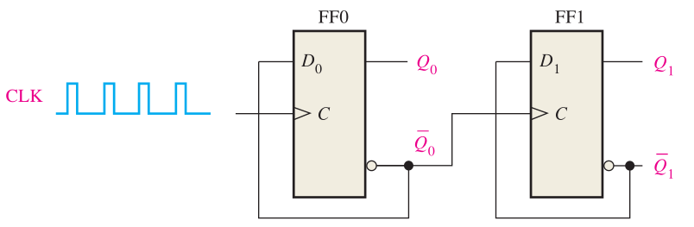
Theoretical Basis
Asynchronous Counter
The term asynchronous refers to events that do not have a fixed time relationship with each other and, generally, do not occur at the same time. An asynchronous counter is one in which the flip-flops (FF) within the counter do not change states at exactly the same time because they do not have a common clock pulse.

Slide 3
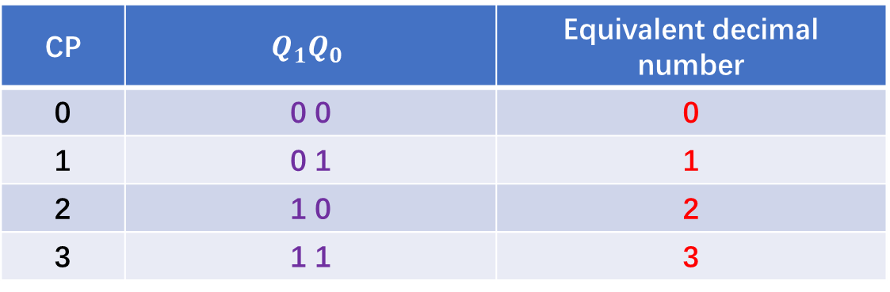

Theoretical Basis
Asynchronous Counter
Asynchronous Binary Up Counter
$Q^{t}$ $Q^{t+1}$
0 + 1 = 1
1 + 1 =1 0
$Q:0→1 or$ $1→0$
Each FF in a binary up counter must satisfies with two conditions:
The next state of the FF will be changed, when a counting pulse appears.
The FF must output a carry bit to another FF.
CP | $$Q_{1}Q_{0}$$ | Equivalent decimal number
0 | 0 0 | 0
1 | 0 1 | 1
2 | 1 0 | 2
3 | 1 1 | 3
Toggle !

Slide 4


Theoretical Basis
Asynchronous Counter
Asynchronous Binary down Counter
${ Q}^{t}$ $Q^{t+1}$
10 - 1 = 1
1 - 1 = 0
$Q:0→1 or$ $1→0$
Each FF in a binary down counter must satisfies with two conditions:
The next state of the FF will be changed, when a counting pulse appears.
The FF must output a borrow bit to another FF.
CP | $$Q_{1}Q_{0}$$ | Equivalent decimal number
0 | 1 1 | 3
1 | 1 0 | 2
2 | 0 1 | 1
3 | 0 0 | 0
Toggle !

Slide 5
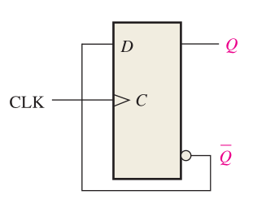
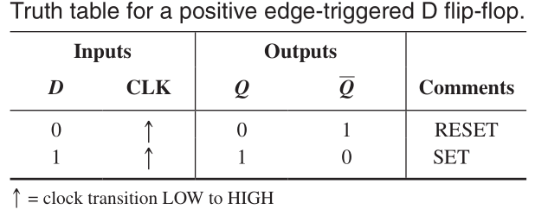
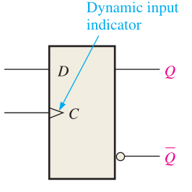


Theoretical Basis
Asynchronous Counter
Basic Counter Unit with FF
A counter can be designed using a D-FF or JK-FF, where a FF must have the function of toggle.
$$Q=D$$
$$Q=\overline{D}$$
Toggle !

Slide 6
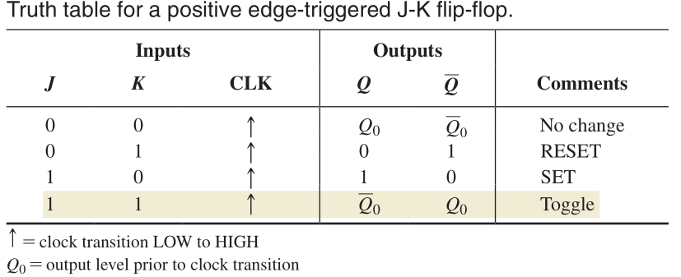
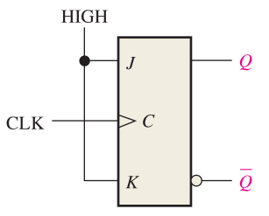
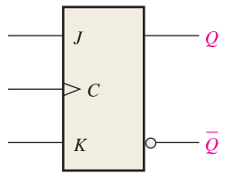

Theoretical Basis
Asynchronous Counter
Basic Counter Unit with FF
A counter can be designed using a D-FF or JK-FF, where a FF must have the function of toggle.
$$J=K=1$$
Toggle !

Slide 7
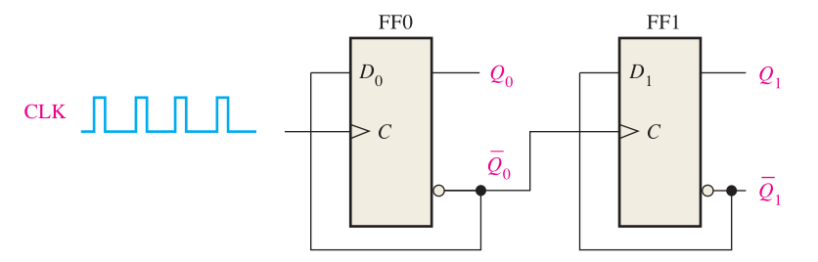
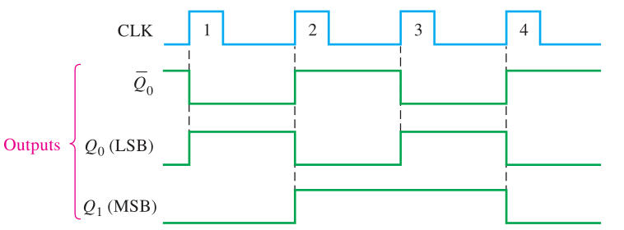
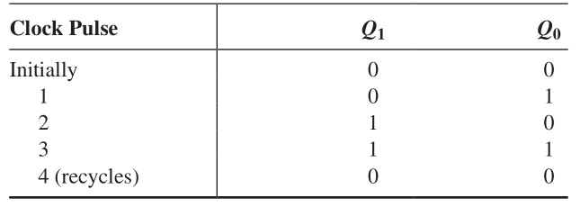
Theoretical Basis
Asynchronous Counter
A 2-Bit Asynchronous Binary Counter
A 2-bit counter connected for asynchronous operation as follows.
Notice that the clock (CLK) is applied to the clock input (C) of only the first flip-flop, FF0, which is always the least significant bit (LSB). The second flip-flop, FF1, is triggered by the Q₀ output of FF0. FF0 changes state at the positive-going edge of each clock pulse, but FF1 changes only when triggered by a positive-going transition of the Q₀ output of FF0.

Slide 8
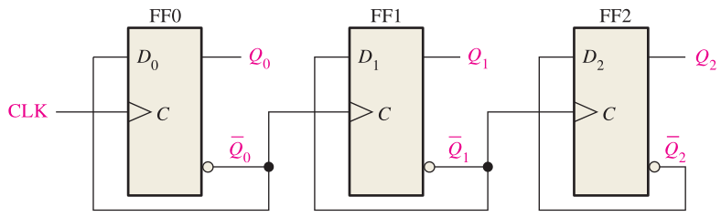
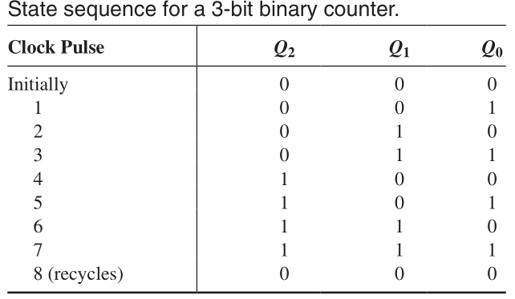
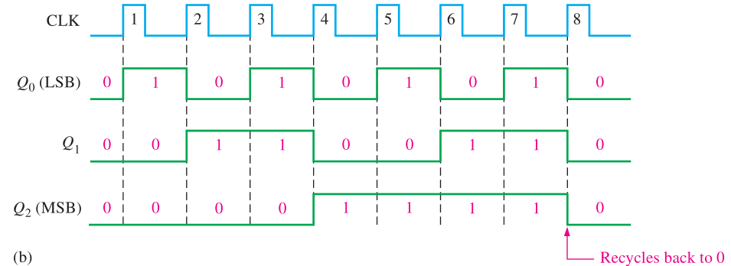
Theoretical Basis
Asynchronous Counter
A 3-Bit Asynchronous Binary Counter
A 4-bit counter connected for asynchronous operation as follows.

Slide 9
Experiments
Experimental purposes
Test the function of a 4-bit asynchronous binary up counter designed by JK-FF.
Understand how to design and test a 4-bit asynchronous binary up counter using JK-FF.
Understand how to design and test a 3-bit asynchronous binary up counter using D-FF.
Understand how to design and test a 3-bit asynchronous binary down counter using D-FF.

Slide 10
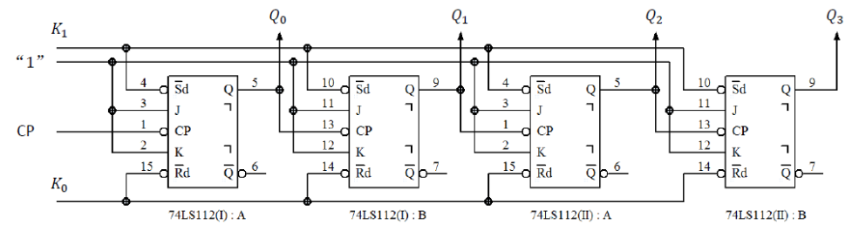
Experimental Contents
Task 1. Test an asynchronous binary up counter
Step 1: Design an 4-bit asynchronous binary Up Counter with JK flip-flop
There are four JK-FF in two 74LS112 chips

Slide 11
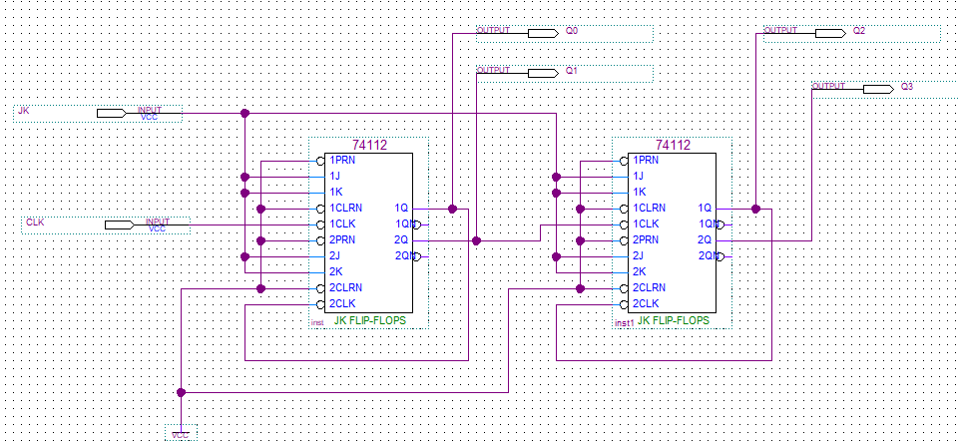
Experimental Contents
Task 1. Test an asynchronous binary up counter
Step 2: Design the circuit in Quartus 13.1
CP | Q₃Q₂Q₁Q₀
0 | 0 0 0 0
1 | 0 0 0 1
2 | 0 0 1 0
3 | 0 0 1 1
4 | 0 1 0 0
5 | 0 1 0 1
6 | 0 1 1 0
7 | 0 1 1 1
8 | 1 0 0 0
9 | 1 0 0 1
10 | 1 0 1 0
11 | 1 0 1 1
12 | 1 1 0 0
13 | 1 1 0 1
14 | 1 1 1 0
15 | 1 1 1 1

Slide 12
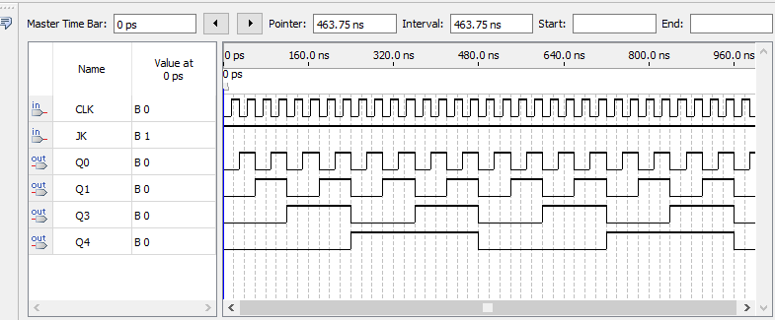
Experimental Contents
Task 1. Test an asynchronous binary up counter
Step 3: Compile the designed file, and construct the VMF to watch the simulation results about Q₃Q₂Q₁Q₀
This counter also is a frequency divider!

Slide 13
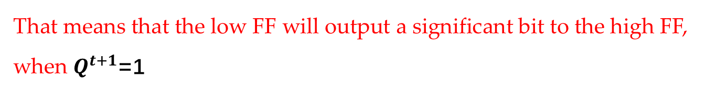
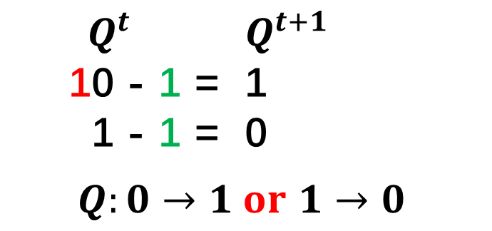
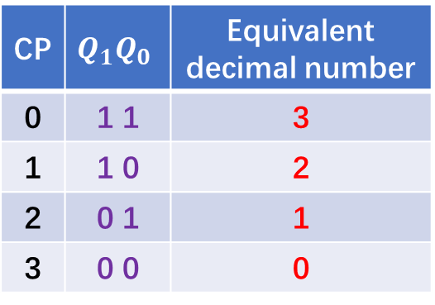
Experimental Contents
Task 2. Design and Test an asynchronous binary down counter
Principles:
CP | $$Q_{1}Q_{0}$$ | Equivalent decimal number
0 | 1 1 | 3
1 | 1 0 | 2
2 | 0 1 | 1
3 | 0 0 | 0
The FF used has the function of toggle.
The FF must output a borrow bit to another FF.
${ Q}^{t}$ $Q^{t+1}$
10 - 1 = 1
1 - 1 = 0
$Q:0→1 or$ $1→0$
That means that the low FF will output a significant bit to the high FF, when $Q^{t+1}$=1
Toggle !

Slide 14
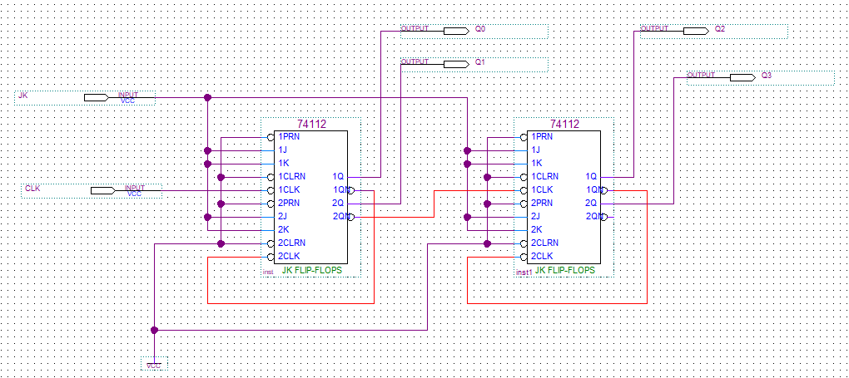
Experimental Contents
Task 2. Design and Test an asynchronous binary down counter
The circuit designed:
CP | $$Q_{1}Q_{0}$$ | Equivalent decimal number
0 | 1 1 | 3
1 | 1 0 | 2
2 | 0 1 | 1
3 | 0 0 | 0
${ Q}^{t}$ $Q^{t+1}$
10 - 1 = 1
1 - 1 = 0
$Q:0→1 or$ $1→0$
The low FF will output a significant bit to the high FF, when $Q^{t+1}$=1
Toggle !

Slide 15
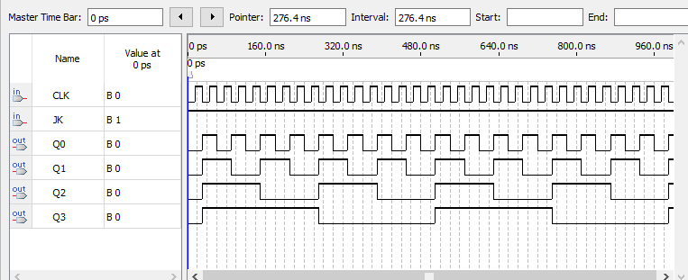
Experimental Contents
Task 2. Design and Test an asynchronous binary down counter
The simulation results:
CP | $$Q_{1}Q_{0}$$ | Equivalent decimal number
0 | 1 1 | 3
1 | 1 0 | 2
2 | 0 1 | 1
3 | 0 0 | 0
${ Q}^{t}$ $Q^{t+1}$
10 - 1 = 1
1 - 1 = 0
$Q:0→1 or$ $1→0$
The low FF will output a significant bit to the high FF, when $Q^{t+1}$=1
Toggle !

Slide 16
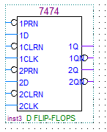
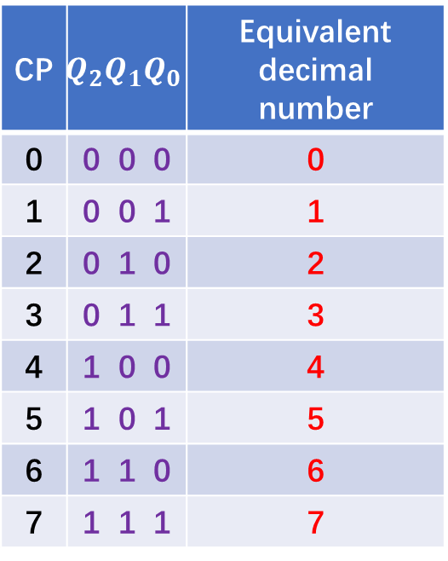
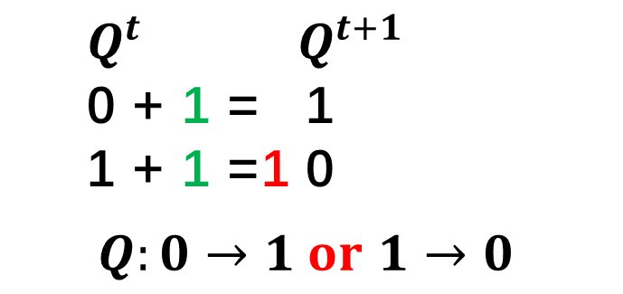
Experimental Contents
Task 3. Design and Test an 3-bit asynchronous binary up counter using D-FF
CP | $$Q_{2}Q_{1}Q_{0}$$ | Equivalent decimal number
0 | 0 0 0 | 0
1 | 0 0 1 | 1
2 | 0 1 0 | 2
3 | 0 1 1 | 3
4 | 1 0 0 | 4
5 | 1 0 1 | 5
6 | 1 1 0 | 6
7 | 1 1 1 | 7
$Q^{t}$ $Q^{t+1}$
0 + 1 = 1
1 + 1 =1 0
$Q:0→1 or$ $1→0$
Toggle !
74LS74!

Slide 17
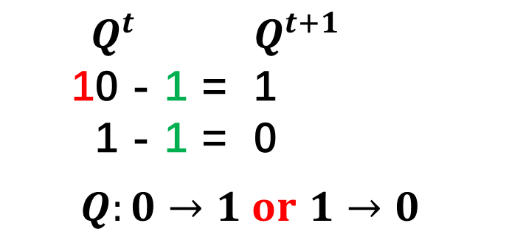
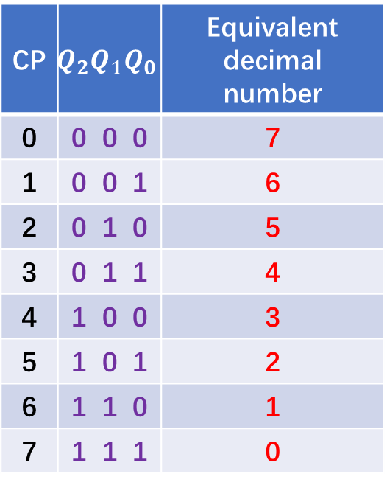
Experimental Contents
Task 4. Design and Test an 3-bit asynchronous binary down counter using D-FF
CP | $$Q_{2}Q_{1}Q_{0}$$ | Equivalent decimal number
0 | 0 0 0 | 7
1 | 0 0 1 | 6
2 | 0 1 0 | 5
3 | 0 1 1 | 4
4 | 1 0 0 | 3
5 | 1 0 1 | 2
6 | 1 1 0 | 1
7 | 1 1 1 | 0
${ Q}^{t}$ $Q^{t+1}$
10 - 1 = 1
1 - 1 = 0
$Q:0→1 or$ $1→0$
Toggle !
74LS74!

Slide 18
Thanks

